Slide 1


Slide 2
Study of Strata Control in an U/G Coal Mine being worked by Continuous Miner

Slide 3
OBJECTIVES & SCOPE OF PROJECT
To study the working of an underground coal mine being worked by a continuous miner.
To analyze the problems encountered in the overlying strata while extracting coal using a continuous miner.
To understand the process of strata evaluation currently done in the mine and to suggest measures for improvement in the strata evaluation techniques.
To carry out a case study for working done by continuous miner in Sarpi Project, Joy Mining.
To draw out conclusions in regard of strata control measures required to support the roof strata
To point out the limitations and advantages of the existing strata control techniques.
To suggest innovative strata measures for improvised strata control for optimum productivity of the mine.

Slide 4
INTRODUCTION- CONTINUOUS MINER
First introduced in the late 1940's, continuous miners provided a quantum leap in the speed and efficiency of extracting coal.
Modern versions operate on basically the same principal as their predecessors using a large rotating steel drum equipped with tungsten carbide steel 'teeth' or cutting bits to cut the coal.
Modern continuous miners are highly productive and are remotely controlled being designed for a variety of seams and mining conditions.
These make possible even fuller recovery of the available coal, while removing the machine operator further from the working area.

Slide 5
CONTINUOUS MINER
Continuous miners operate a room and pillar mining system.
A series of 18 to 20 foot wide rooms are driven in the coal bed with pillars or columns of coal left standing to help support the roof.
Roof bolts, typically four to six feet long steel bolts, are inserted into holes bored into the roof to bind the strata together support the roof.
Robotic continuous miners are now being developed for more automatic operations.
These offer a vision of what could become the standard coal mining method of the not too distant future.

Slide 6
CONTINUOUS MINER
Continuous Miner is used in India at the following places-:
Chirmiri Area(S.E.C.L.)
Kurasia Colliery(S.E.C.L.)
Jhanjhara Project (E.C.L.)
Sarpi Project (For introduction of Continuous Miner at Sarpi Project of ECL, agreement with Joy Mining Machinery Limited was signed on 4th April ’09)

Slide 7
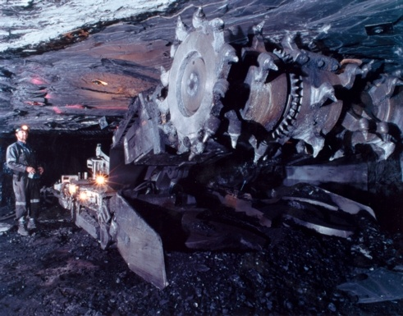

Slide 8
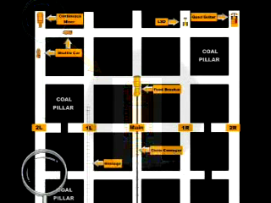
OTHER MACHINERY USED WITH CONTINUOUS MINER
Shuttle Car
Quad Bolter
Feed Breaker
Belt Conveyor
LHD

Slide 9
FUTURE PROSPECTS OF CONTINUOUS MINER
'Intelligent' mining machines completely controlled by computers, with sensors that pinpoint the positions of all moveable parts, and onboard control systems that run the equipment and collect data on the coal seam.
A robotic miner would have its own navigation and guidance systems, as well as internal diagnostics to spot problems and video equipment to allow continuous monitoring of the mining operation by highly trained personnel located in a safe position either underground or on the surface.

Slide 10
LITERATURE REVIEW Need for Strata Control
Mines with a well-developed understanding of the risk profile related to the disturbances caused by the strata enjoy better business outcomes in terms of-:
Safety
Productivity
Cost control
Profitability
Reputation.
Other mines without systems for strata control, consume a phenomenal amount of time and energy dealing with day-to-day issues, without ever gaining effective control of the critical issues that drive their business. Unscientific monitoring of coal mining strata has resulted in a number of fatal and serious bodily injuries to miners and loss of production from time to time.

Slide 11
Legislation Related to Strata Control
During the 10th National Conference of Safety in Mines held at New Delhi during 26-27th Nov, 2007 it was recommended that-:
Each coal mining company shall establish a STRATA CONTROL CELL at corporate and area levels within a period of one year.
The purpose of these strata control cells will be to assist mine managers for-:
formulation of Systematic Support Rules
monitoring strata control measures in a scientific way
ensuring efficiency of support system
procurement/supply of quality supporting materials

Slide 12
PROCESS OF STRATA CONTROL
Estimate the types of geological conditions likely to be encountered in roadway development.
Assessment of the stability of roadways to be developed in geological conditions likely to be encountered
Development of support measures that will provide roadway stability in geological conditions likely to be encountered.
Preparation of support plans that explain in full detail the means of roadway support required to be installed and prepared in a manner such that they may be readily understood by those required to install roadway support.
Provision of safe, effective and systematic work methods for the installation, and subsequent removal where required, of roadway support (including support in connection with the carrying out of roof brushing operations)

Slide 13
PROCESS OF STRATA CONTROL
(contd.)
Provision of adequate equipment and resources to effectively install or remove roadway support.
Monitoring of the stability of roadways after formation and support installation.
Training of employees, including; support design principles, support plan interpretation, placement and removal, understanding the need for and importance of the various support systems, recognition of indicators of change that may affect roadway stability.
Recording of geological features that may affect roadway stability.
Recording of roof failures that have the potential to cause injury to persons.
Conducting of periodic compliance audits (not exceeding 12 months)
Reviewing of the application and effectiveness of the support rules at intervals not exceeding 12 months.

Slide 14
FACTORS AFFECTING STRATA CONTROL
Ability to control the rate of closure of the mined opening i.e. strata control (mainly roof control but floor movement cannot be ignored).
This will include setting and yield loads, support stiffness, system pressure and support geometry.
Load distribution on roof and floor strata, closely allied with the above but with different connotations.
Support operating height range to handle seam thickness variations and to enable transport around the mine when fully closed.

Slide 15
FACTORS AFFECTING STRATA CONTROL(contd.)
Overall size and weight for transport purposes.
Ergonomic aspects both for operation (largely ease of travel along the face) and for maintenance/parts replacement purposes.
Cost has intentionally been excluded from the list of considerations. It may be a factor in deciding between two otherwise satisfactory offers or may be the deciding factor in continuing or abandoning a project. It should not be a consideration in determining the adequacy of support systems which should be a purely engineering exercise.

Slide 16
BASIS OF SUPPORT DESIGN-RMR
The support system, required to be developed for strata control, employs a quantified assessment of roof strata called Rock Mass Rating(RMR) which takes into account-:
Layer thickness in immediate roof
Structural Features
Rock Weatherability
Strength of the roof rock
Ground water seepage
Each of these parameters were assigned weightages in order of their impact on the roof stability.

Slide 17
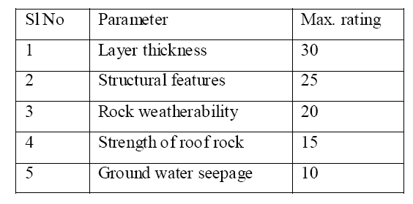
CMRI Prescribed Parameters for RMR Determination
The value of these parameters is obtained for underground galleries and RMR is obtained for the type of strata occurring in the roof.

Slide 18
COMBINED RMR
Rock Mass Rating (RMR) is the sum of five parameter ratings. If there are more than one rock type in the roof, RMR is evaluated separately for each rock type and the combined RMR is obtained as:
Σ (RMR of each bed * bed thickness)
Combined RMR = --------------------------------------------
Σ (Thickness of each bed)
The RMR so obtained may be adjusted if necessary to take account for some special situations in the mine like depth, stress, method of work.

Slide 19
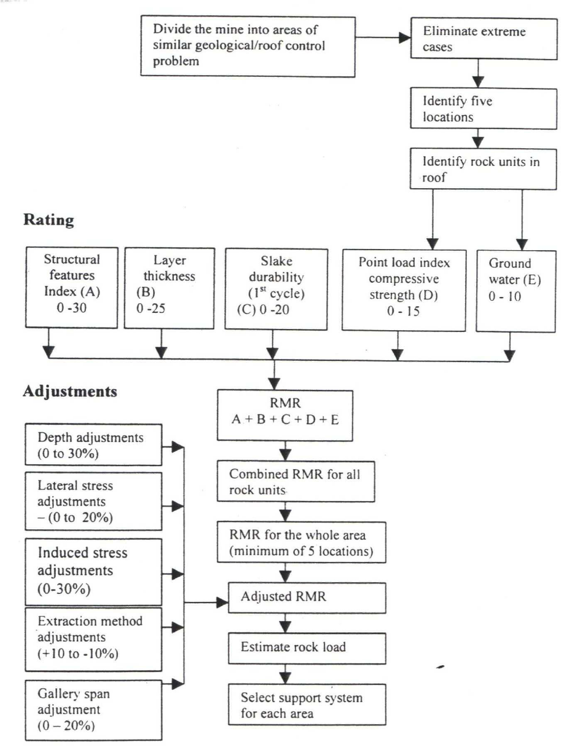
FLOW SHEET FOR DERIVING RMR

Slide 20
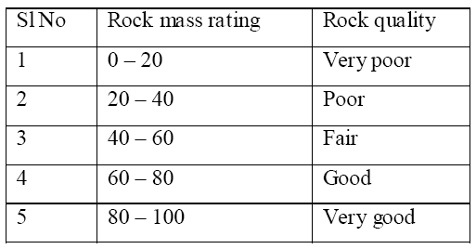
Classification of Immediate Roof Strata
The value of RMR worked out is adjusted for different mining parameters and then is used for classifying roof strata in five categories-:

Slide 21
SALAMON & MUNRO METHOD FOR PILLAR STRENGTH The method of Salamon and Munro is very widely used but all methods have similar behaviour. The strength of a pillar decreases as its height increases. The strength of a pillar increases as its width increases. For pillars where the w:h is less than 5

Slide 22
PILLAR STRENGTH
The method of Salamon and Munro is very widely used but all methods have similar behaviour
The strength of a pillar decreases as its height increases
Strong Medium Weak

Slide 23
PILLAR STRENGTH
The strength of a pillar increases as its width increases
Weak Medium Strong

Slide 24
PILLAR STRENGTH
Pillar height h = 3.7m
w = 19m
Pillar width
19
0
.
46
strength
=
7
.
176
= 7.176 x 3.87
2.37
= 11.71MPa
3.7
0
.
66

Slide 25
Stress at Depth
The vertical or virgin stress is calculated by determining the weight of a column
of rock overlying the coal seam
1m²
At Chirimiri the depth in the eastern area is around 60 to 120m
Vertical load = density x gravity x depth
= 2500 x 10 x 120m
= 3,000,000N/m²
= 3.0 MPa
At 60m depth it is 1.5MPa
In England some of the mines are over 1000m deep and the virgin stress is around 25Mpa
Vertical stress and virgin stress
Depth 67 to120m

Slide 26
Pillar Load
Pillar load is calculated using Tributary Area Theory:
Simply assumes the equal size pillars in a regular pattern
carry equal loads and that the load is that of a column of rock
lying over the pillar, b in this case is the bord width (gallery width)
(w+b)
Surface
Load = 120 x (w+b)² ρxg
= 120 x 25² x 2500 x 10
= 1 875,000,000N
Over the area of the pillar = 1 875,000,000N
19²
Column of rock
120m
= 5.19 MPa
Coal pillar
19m

Slide 27
Pillar Safety Factor
Safety Factor:
= Strength
Load
= 11.71
5.19
the pillar strength is from the previous example
= 2.26 this is a stable safety factor
At 60m the depth is exactly half and the load on the pillar will
also be halved so the safety factor will be doubled
as the pillar strength remains the same, that is 4.52

Slide 28
Pillar Safety Factor
All in one formula:
Where w is pillar width in m
D is Depth to floor
h is the mining height
B is the bord width

Slide 29
Factors affecting Pillar Stability
Geological | Mine design
Depth | Mining sequence
Overburden thickness and physical characteristics | Pillar size and strength
Coal bed thickness and physical characteristics | Road widths and roof spans
Immediate roof and floor stratigraphy | Percentage extraction/volumetric
Discontinuity influence | Mining layout
In situ stress fields | Geometric layout of workings, Support methods, Time

Slide 30
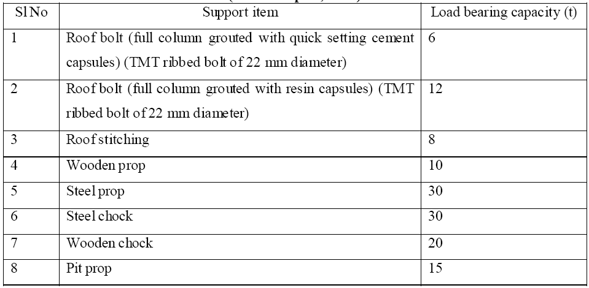
Types of Supports used in Coal Mines (CMRI Report, 1987)

Slide 31
METHODOLOGY Principle Of Rock Support
The basic principle behind supporting the rocks of the overlying strata is-:
To support the rock load we need to give support higher than the rock load at that area so that the roof will not fall.
Type and capacity of various supports are chosen from the previous table for design of the support system in bord and pillar workings.

Slide 32
STAGES OF SUPPORT DESIGN
The various stages of designing a suitable support system and ensuring successful installation are basically as follows:
Geo-technical survey
Interpretation of survey findings .
Selection/designing of support system based on above interpretation.
Selection of equipment.
Actual installation process.
Monitoring of the system.

Slide 33
DETERMINATION OF ROCK LOAD
With RMR obtained for the roof strata, the likely rock load can also be worked out by employing the following empirical equation:
Rock load = B × D × F(1.7 - 0.037 × RMR + 0.0002 × RMR²)
where B: width of galleries/splits
D: average rock density
F : safety factor
A safety factor of 1.5 is generally considered enough.

Slide 34

A pattern of support may be proposed by the following formula-: S= (N*Bc) / (W*Sp) where, N = no. of bolts/props in a row Bc = Grouted roof bolt capacity W = width of the slice Sp= spacing between two rows An adequate support safety factor should be achieved-: about 1.1-1.25 in depillaring areas about 1.5-2.0 for permanent roadways
SUPPORT ESTIMATION

Slide 35
DATA ASSIMILATION Specification of Machines in Sarpi Project Continuous Miner (12CM15)
Operating Voltage 1050 VAC
Remote Radio Remote
Weight 58 Te.
Dimension LBH 11020 X 2770 X 1005 mm
Ground clearance 305 mm
Ground bearing pressure 184 Kpa
Cutting height 2160 - 4600 mm
Cutting width 3300 mm
Cutting drum dia 1120 mm
Drum speed 50 RPM
Bit tip speed 175 mtr./min.
No. of Bit 66
Bit attack angle 55 degree
Water pressure required 300 psi
Loading Rate 15 - 27 Te./min.

Slide 36
QUAD-BOLTER (RT132)
Operating Voltage 1050 V AC
Total Rating 126 KW
Weight 29800 Kg.
Ground clearance 295 mm
Ground bearing pressure 98 Kpa
Bolting Rate upto 25 bolt/hour
Bolting height max. 5375 mm
Min. operating width 3160 mm
Water pressure required 100-175 Psi
Water flow required 100 Ltr./min.
Traction speed 33 mtr./min
Rotation speed 550 rpm
Rotation Torque 384 NM

Slide 37
SHUTTLE CAR (10SC32 B)
Operating Voltage 1050 V AC
Total Rating 202.6 KW
Weight 20500 Kg
Dimension LBH 8.99 X 3.05 X 1.31 mtr.
Cubic capacity 10.19 Cubic meter
Ground clearance 290 mm
Ground bearing pressure 520 KPA ( Empty)
830 KPA ( Loaded)
Gradient 6 Degree aproxx.
Conveyor slow speed 0.191 m/s
Conveyor fast speed 0.342 m/s
Discharge time 30-45 Sec.
Turning Radius, Inside 2.59 mtr.
Turning Radius, Outside 6.43 mtr.

Slide 38
FEEDER BREAKER (14BF)
Operating Voltage 1050 V AC
Total Rating 112 KW
Dimension 9144 X 3059 mm
Ground clearance Loading end 203 to 406 mm
Ground clearance Discharge end 203 to 584 mm
Conveyor width 1270 mm
Type of intake 3 way
Dump Coal size IN 400 X 600 X 700 mm
Coal size OUT Minus 200 mm
Coal Discharge 250 - 500 Tph
Traction speed 12 mtr./min.

Slide 39

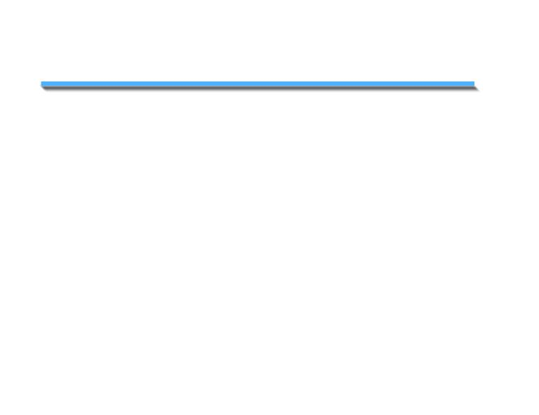
– MEASUREMENT
R M T
Coal India
Rock Mechanics
Technology
ECL
INSTALLATION OF ROTARY
SINGLE HEIGHT TELLTALES
Ground Control Training Programme 125 of 390

Slide 40
– MEASUREMENT
STEP 1
R M T
Coal India
Rock Mechanics
Technology
ECL
Drill a vertical 28mm/35mm
diameter hole in the roof
to 4m minimum above
the roofline.
28mm Ø
Min: 4m
Ground Control Training Programme

Slide 41
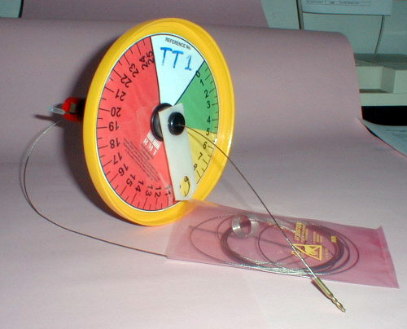
– MEASUREMENT
STEP 2
R M T
Coal India
Rock Mechanics
Technology
ECL
Remove the telltale
from its packaging.
Unwind the anchor wire,
taking care not to
tangle the wire
Ground Control Training Programme

Slide 42
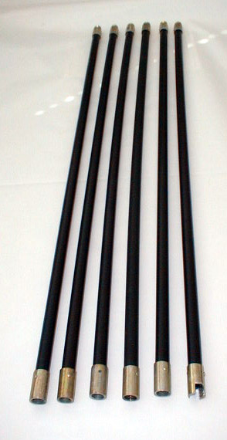
– MEASUREMENT
STEP 3
R M T
Coal India
Rock Mechanics
Technology
ECL
Connect together the
telltale installation rods
ensuring the special
adapter is at the top
Anchor spring adaptor
to the top
Ground Control Training Programme

Slide 43
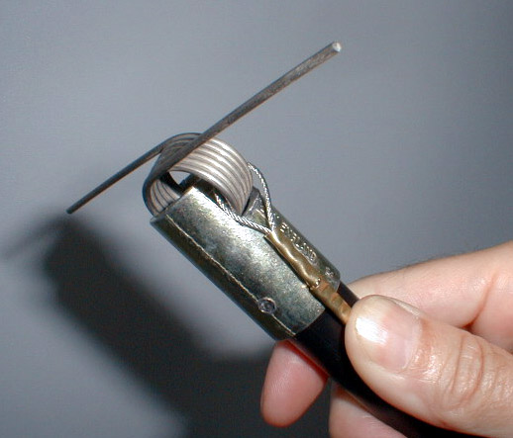
– MEASUREMENT
STEP 4
R M T
Coal India
Rock Mechanics
Technology
ECL
Clip the telltale wire
‘end anchor spring’ into
the adapter at the top of
the installation rods
Ground Control Training Programme

Slide 44
– MEASUREMENT
STEP 5
R M T
Coal India
Rock Mechanics
Technology
ECL
Place the installation rods
and anchor spring into
the mouth of the roof hole,
ensuring concentricity
Ground Control Training Programme

Slide 45
– MEASUREMENT
STEP 6
R M T
Coal India
Rock Mechanics
Technology
ECL
Make sure the anchor wire is
hanging freely, then push the rods to the back of the roof hole.
Remove installation rods.
Ground Control Training Programme

Slide 46
– MEASUREMENT
STEP 7
R M T
Coal India
Rock Mechanics
Technology
ECL
Slide the telltale reference tube/dial plate assembly up the anchor wire and install the reference tube into the hole.
Ground Control Training Programme

Slide 47
– MEASUREMENT
STEP 8
R M T
Coal India
Rock Mechanics
Technology
ECL
Turn the dial pointer fully
anticlockwise until it reaches
the bottom of its travel
Ground Control Training Programme

Slide 48
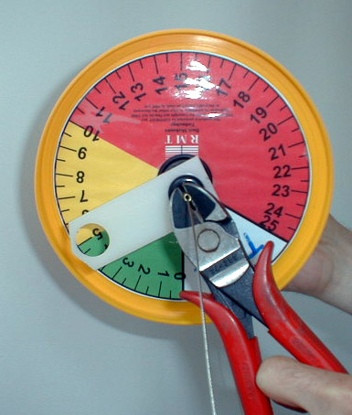
– MEASUREMENT
STEP 9
R M T
Coal India
Rock Mechanics
Technology
ECL
Using a pair of pliers, slide the free ferrule from the end of the hanging wire until it contacts the end of the telltale pointer.
Carefully position the ferrule on
the wire such that the telltale indicator is lifted approximately
1mm of indication off the bottom
of its travel, then crimp the ferrule lightly
Ground Control Training Programme

Slide 49
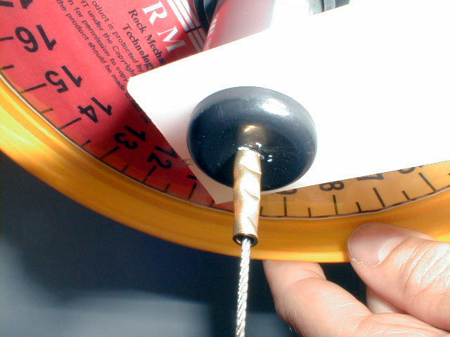
– MEASUREMENT
STEP 10
R M T
Coal India
Rock Mechanics
Technology
ECL
Once satisfied with the
position of the ferrule crimp the ferrule 3 times to secure
Ground Control Training Programme

Slide 50
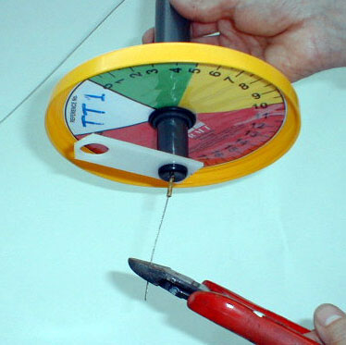
– MEASUREMENT
STEP 11
R M T
Coal India
Rock Mechanics
Technology
ECL
Remove surplus wire
Ground Control Training Programme

Slide 51
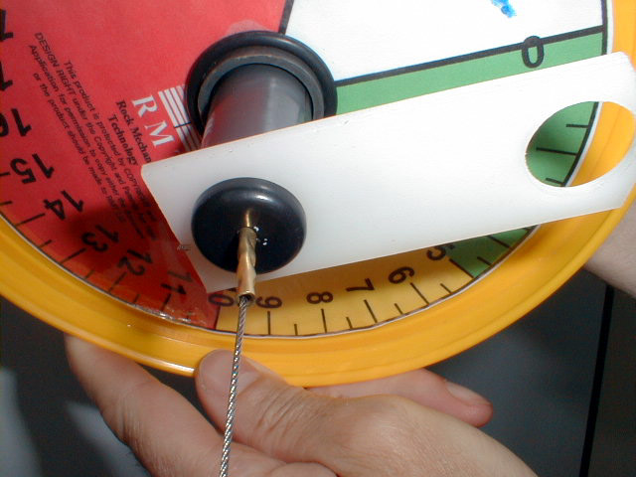
– MEASUREMENT
STEP 12
R M T
Coal India
Rock Mechanics
Technology
ECL
Turn the dial backing plate until the zero aligns with the pointer
Ground Control Training Programme

Slide 52
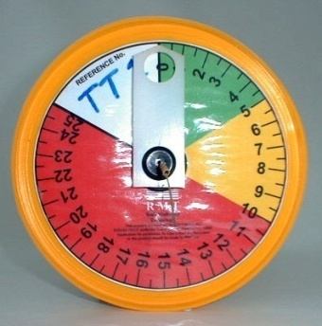
– MEASUREMENT
READING TELL TALES
R M T
Coal India
Rock Mechanics
Technology
ECL
It should be the the responsibility of the MINER each shift to record the tell tales by colour for all active areas in the section.
A book should be kept at the section WAITING PLACE in which each shifts tell tale readings are recorded.
Where a colour change takes place this should be reported on the Shift Boss’s statutory shift report, together with comment on any remedial actions taken. In addition the Shift Boss should record the millimetre reading of the relevant tell tales.
EACH SHIFT
READ BY COLOUR :-
GREEN
YELLOW, OR
RED
IF A COLOUR
CHANGE
TAKES PLACE
READ BY NUMBER
Ground Control Training Programme

Slide 53
– MEASUREMENT
R M T
Coal India
READING TELL TALES
Rock Mechanics
Technology
ECL
Once per week, the MINER should, in addition to recording his
shiftly observations by colour, record the millimetre reading on each
tell tale in his section (active areas).
This information should be recorded on a weekly sheet, which should
be passed to the nominated ROOF CONTROL AUDITOR for trend
analysis.
EACH WEEK
READ BY MILLIMETRES :
0 mm
Ground Control Training Programme

Slide 54
– MEASUREMENT
ACTION LEVELS
R M T
Coal India
Rock Mechanics
Technology
ECL
GREEN 0 - 5 mm
YELLOW >5 - 10 mm
RED 10 mm +
Ground Control Training Programme

Slide 55
– MEASUREMENT
ACTIONS
R M T
Coal India
Rock Mechanics
Technology
ECL
GREEN No action required, continue routine monitoring
YELLOW Install additional reinforcement. Length and type
of support to be determined by investigations
co-ordinated by Shift Boss / Mine Overseer / Roof
Control Officer.
RED Restrict access. Consult Shift Boss / Mine Overseer /
Roof Control Officer.
Ground Control Training Programme

Slide 56
– MEASUREMENT
GOLDEN RULE
R M T
Coal India
Rock Mechanics
Technology
ECL
IF YOU SEE ANY TELL TALE
IN YELLOW SECTOR
INFORM YOUR
SUPERVISOR
Ground Control Training Programme

Slide 57
– MEASUREMENT
GOLDEN RULE
R M T
Coal India
Rock Mechanics
Technology
ECL
IF YOU SEE ANY TELL TALE
IN RED SECTOR
WITHDRAW FROM AREA
AND INFORM YOUR
SUPERVISOR
Ground Control Training Programme

Slide 58
.
Dual Height Tell Tale
At sites where medium to high levels of roof deformation are expected, such as within seam R-VII with a coal top and immediate weak mudstone roof, dual height tell tales are recommended as part of the routine monitoring scheme by Golder RMT to confirm that the support system is maintaining stability in the entries.
Dual Height tell tales are low cost, easily installed safety monitoring devices. The reflective colour bands indicate roof movement both within and above the reinforcement height visually. The millimetre scales allow accurate monitoring of movement trends.
It is recommended that these should be installed in the initial developments in all junctions and mid entry points and in areas of geological disturbances to confirm that the support system is maintaining roof stability.

Slide 59
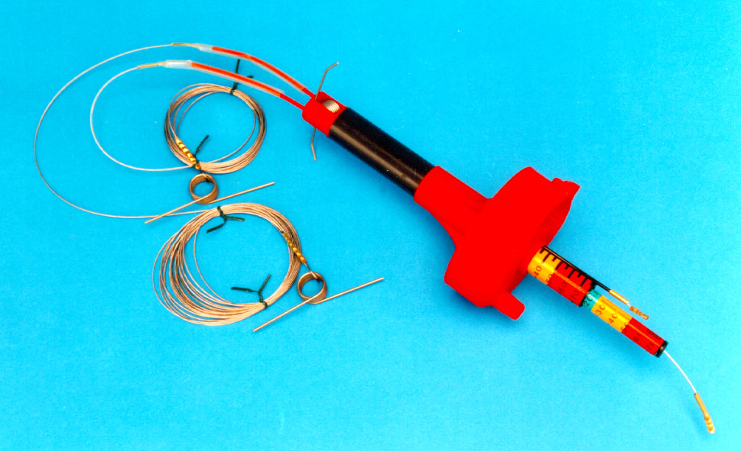
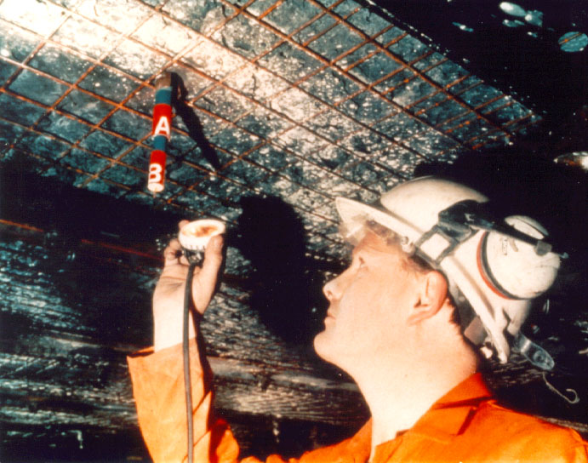
.
Dual Height Tell Tale
.
Typical Dual Height Telltale

Slide 60
.
Dual Height Tell Tale
.
KNOW YOUR ACTION LEVELS
GREEN 0 - 25 mm
YELLOW 25 - 50 mm
RED 50 mm +

Slide 61
CONCLUSIONS Advantages of current Strata Evaluation
Efficient in monitoring the displacement of strata.
Ensures safety of all workers working in the mine.
Reduces risk of roof fall and other strata-related accidents.
Safe working condition leads to heightened morale of employees which boosts the productivity of the mine.
Optimum utilization of continuous miner and other machines deployed in the working.
Minimum wastage of coal resource while carrying out its profitable extraction.

Slide 62
Future Challenges for ECL
It is difficult to match up to the safety standards of an international company as reputed as Joy Mining.
Production from the mine is likely to go down drastically after the termination of agreement with Joy Mining and subsequent shifting of mine control in the hands of ECL.
As Joy Mining is a private company, it is putting in all its efforts for maximizing its profit during the given tenure, which would leave less leverage for ECL to extract coal economically.
New and innovative strata evaluation measures are required to be developed so as to take care of the time-dependent stresses developed in the mine strata during the course of the mine.
Land reclamation and mine closure plan will have to be implemented independently by ECL as a part of mine legislation.

Slide 63
THANK YOU

